Slide 1
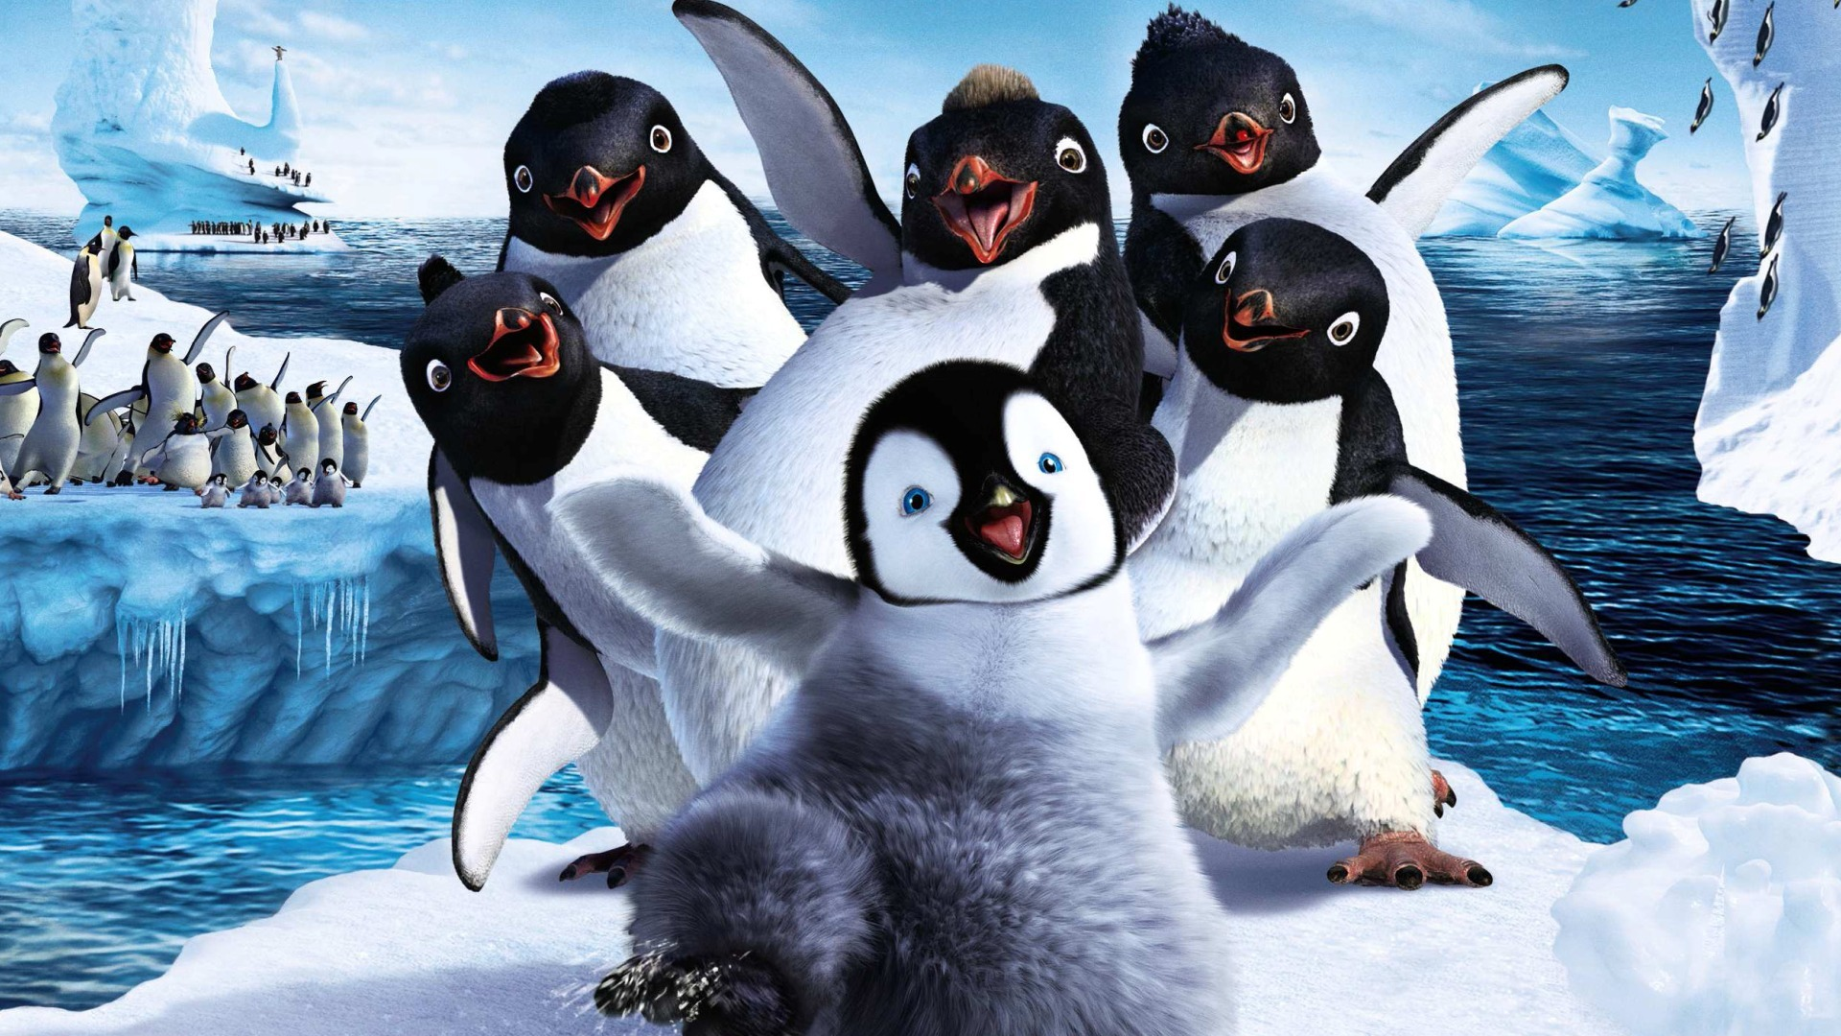

Penguins
By: KENNEY LOGAN

Slide 2
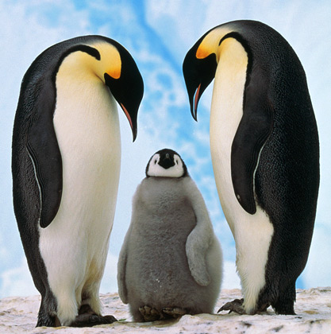

Slide 3
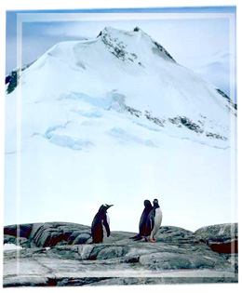
The Scientific name for Penguins are Spheniscidea.

Slide 4
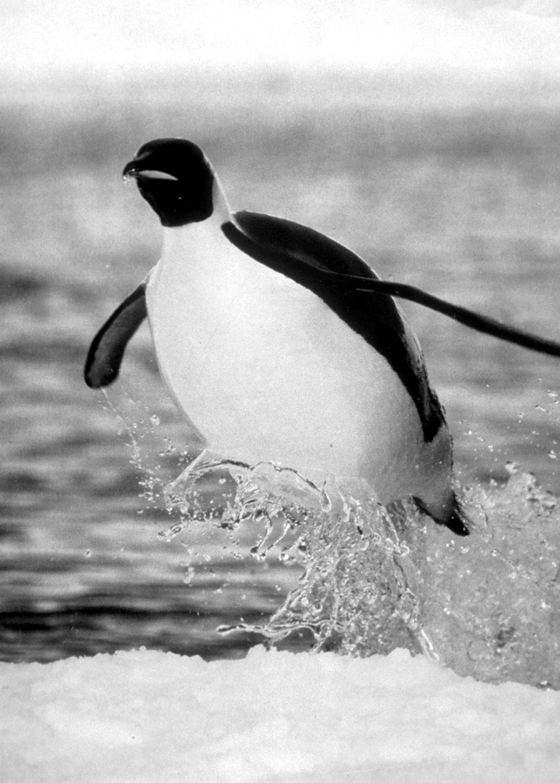

Slide 5
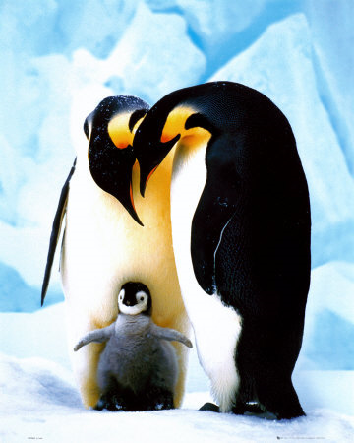

Slide 6
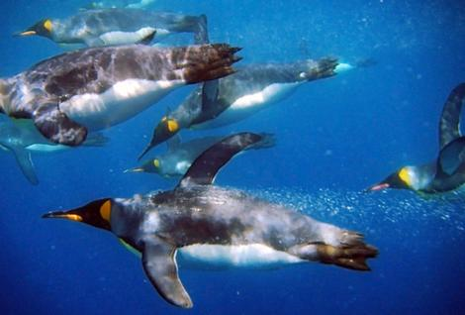

Slide 7
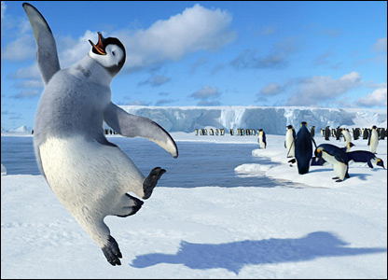

Slide 8
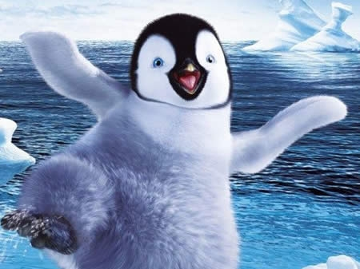

Slide 9
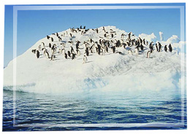
Habitat
All 17 species of penguins live in the Southern Hemisphere; on every continent.
Penguins are abundant on many temperate and sub Antarctic islands.
Penguins generally live on islands and remote conditional regions free from land predators, where their inability to fly isn’t detrimental to their survival.
Although many people make the connection from penguin to cold weather.. They are not only found in cold climates such as Antarctica. In fact, only a few species of penguin live so far south. Several species live in the temperate zone, and one species, the Galapagos Penguin, live near the equator.

Slide 10
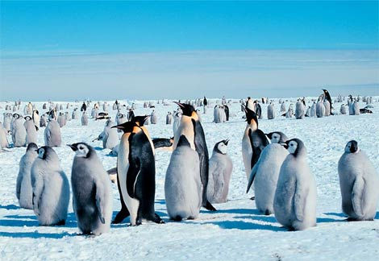

Slide 11
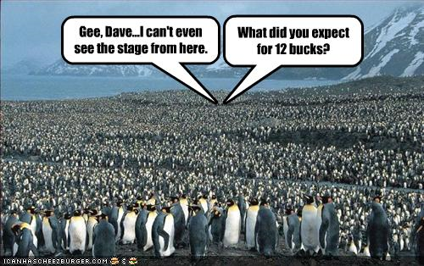

Slide 12
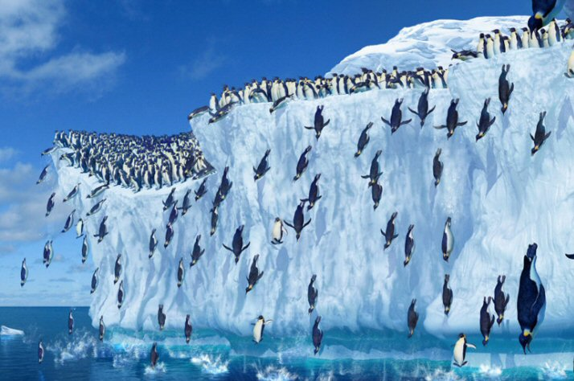

Slide 13
Physical characteristics
The emperor penguin is the largest of all living penguins, standing 3.7 ft and weighing 60-90 lbs.
The smallest of the penguins is the fairy penguin, standing just 16 in and weighing about 2.2 lbs.
The penguin’s body is adapted for swimming. Its body is tapered at both ends and streamlined. A penguin has a large head, short neck, and elongated body.
The tail is short and wedge-shaped.
The legs and webbed feet are set far back on the body, which causes penguins to stand upright when on land.
Wings are modified into paddlelike flippers. The bones are much flattened and, broadened, with the joint of elbow and wrist almost fused. This forms a rigid, tapered, and flat flipper for swimming. Each flipper is covered with short, scale-like feathers. The long wing feathers typical of most birds would be too flexible for swimming through water.

Slide 14
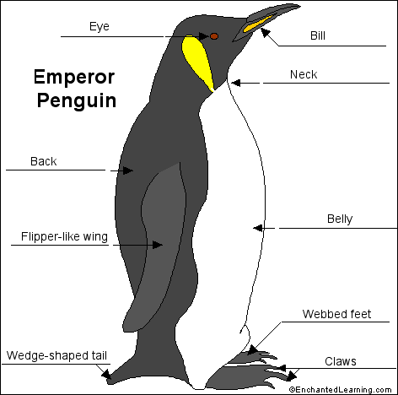
Emperor Penguin

Slide 15
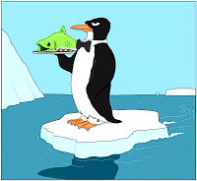
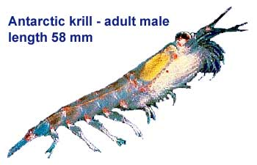
Food
Penguins feed on a range of sea creatures: fish, squid, sardines, anchovies, but most of all, especially the smaller penguins, on krill, a small shrimp.
Antarctic penguins also eat a lot of krill.
Species found a little north, eat mostly fish.
Some penguins chase after rock crabs.
Various species of penguins have slightly different food preferences.
Dailies feed primarily on small krill, while chinstraps forage for large krill .
Emperors and kings primarily eat fishes and squids.
Intake varies with the quantity and variety of food available from different areas at different times of the year.
The location of prey can vary seasonally and even daily
Penguins primarily rely on their vision while hunting
Penguins catch prey with their bills and swallow it whole while swimming
Penguins have a spiny tongue and powerful jaws to grip slippery prey

Slide 16


Slide 17
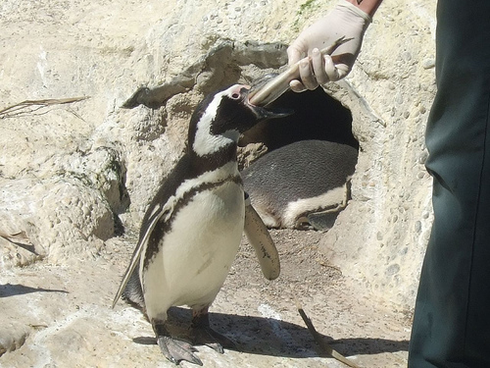
THATS WHAT I THOUGHT

Slide 18
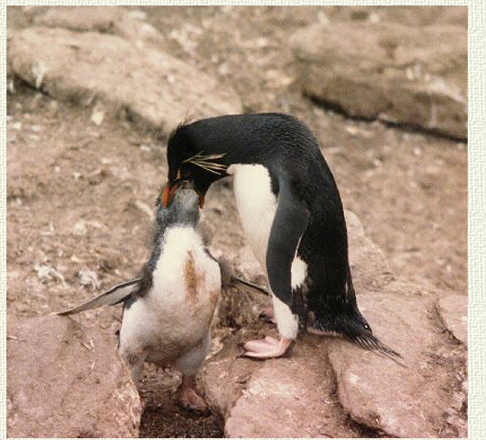
Dis how We Eat

Slide 19
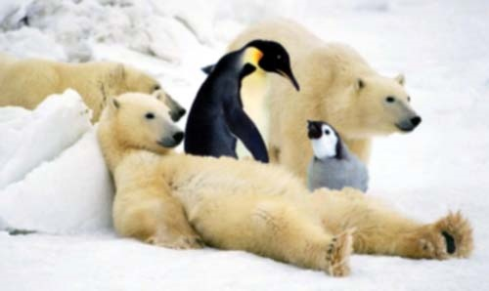
Damn Wrong Area

Slide 20
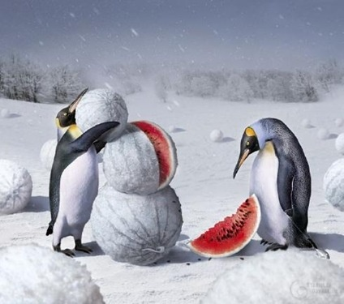
Hmm Melon!!

Slide 21
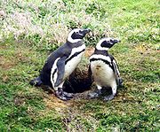
Reproduction
With some of the smaller species, breeding may begin at three or four years, but most larger species are not accomplished breeders until much later. On average, breeding does not begin until the fifth year, and a few males do not breed until the eighth year
Most species have an annual breeding season - spring through summer
The king penguin has the longest breeding cycle of all the penguin species, lasting 14 to 16 months. A female king penguin may produce a chick twice in every three breeding seasons
Both parents take turns incubating the egg. The incubation period lasts from 4 weeks to 66 days.
Depending on the species, penguins lay one to three eggs.

Slide 22
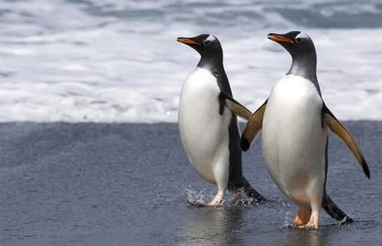
Love in the morning

Slide 23
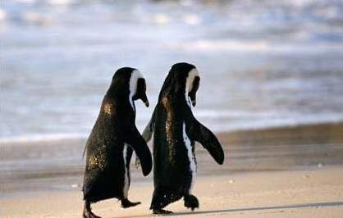
Love To Night

Slide 24
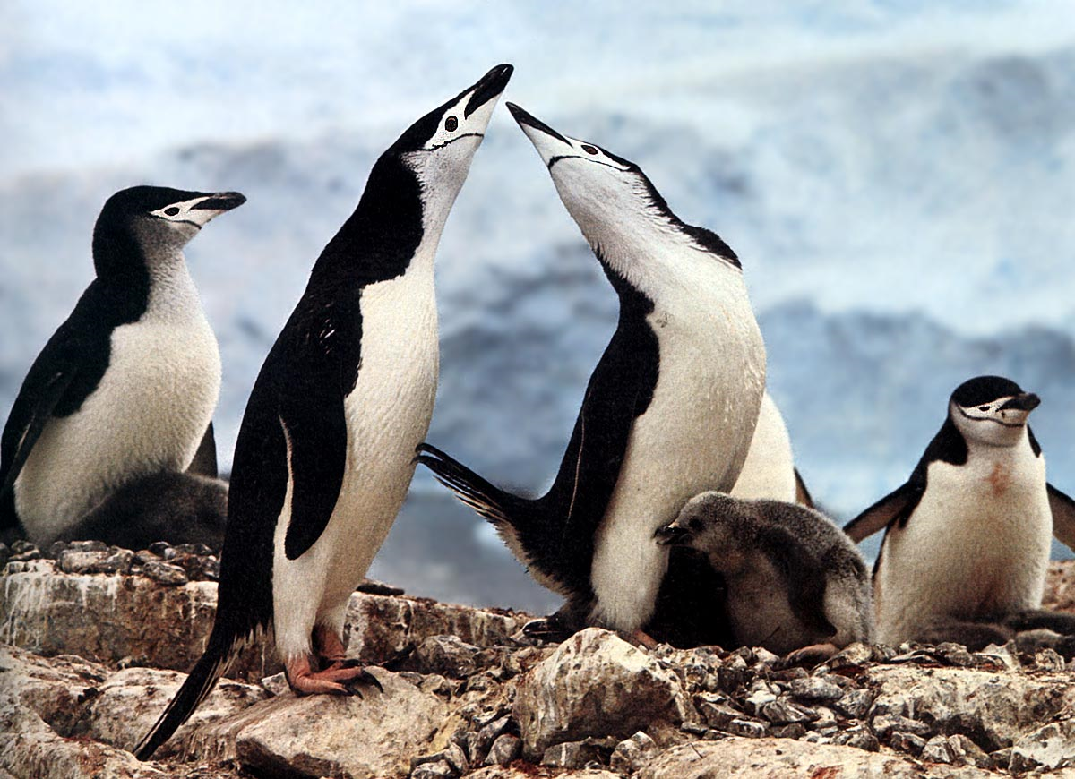

Slide 25
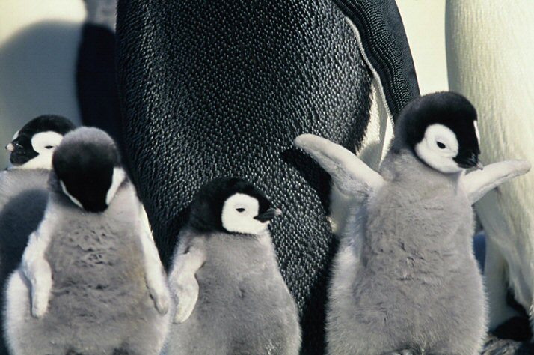

Slide 26
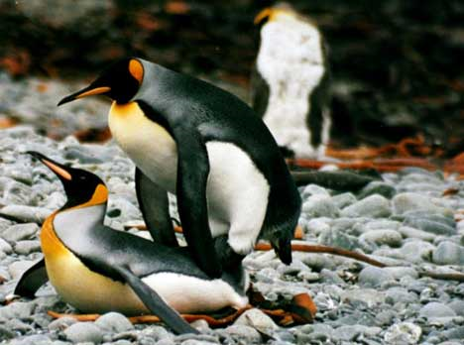
Uhhhh Yea

Slide 27
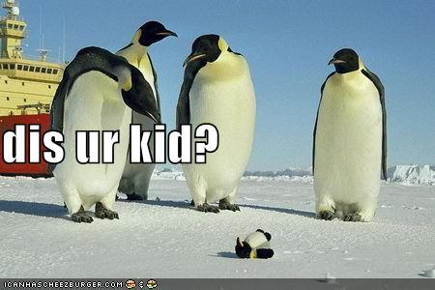
What Happened?

Slide 28
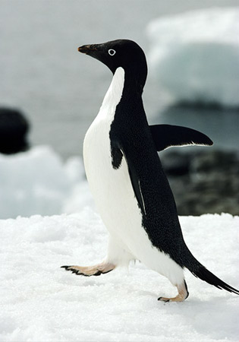
Special Adaptations
Heavy solid bones act like a diver’s weight belt, allowing them to stay underwater.
Their wings, shaped like flippers, help them “fly” underwater at speeds up to 15 mph. A streamlined body, paddle-like feet, insulating blubber, and watertight feathers all add to their efficiency and comfort underwater.
They also have a remarkable deep-diving ability.
In addition to blubber for insulating warmth, penguins have stiff, tightly packed feathers that overlap to provide waterproof.
They coat their feathers with oil from a gland near the tail to increase impermeability.
Black and white counter shading makes them nearly invisible to predators above and below.
Penguins have little or no sense of smell. Like other birds, their sense of taste is limited. Their vision appears to be better when they are underwater.
Most species of penguins build nests, consist of only a pile of rock or dirt. Emperor penguins build no nests; they hold their eggs on top of their feet under a loose fold of skin called the brood patch.

Slide 29
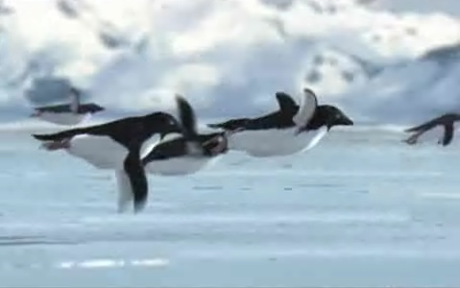
We FLY High

Slide 30
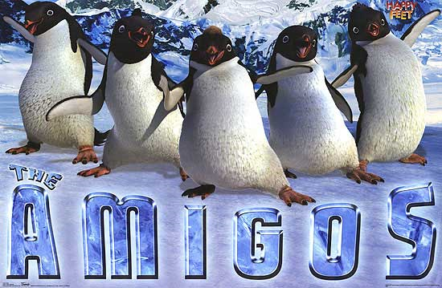

Slide 31
Did you Know
Penguins are birds.
- Their name is derived from Welsh terms ‘pen’, meaning head and ‘Gwyn’, meaning white.
- Penguins do not live at the North Pole.
- Penguins can fly!!!!
• - Their average lifespan is 15-20 years.
- Penguins have insulating layers of air, skin, and blubber.
- Penguins like to slide across the ice on their big stomachs.
- Most penguins can swim about 15 miles per hour.
- There may be as many as 100 million penguins in the world.
Macaroni penguins got their name because of the feathers on their head, which make them look like the well-dressed men of eighteenth-century London who were the focus of the song "Yankee Doodle Dandy."

Slide 32
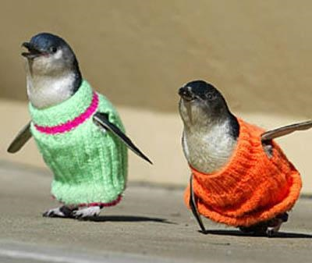
I Gotta stay FLYYaaaaaa000

Slide 33
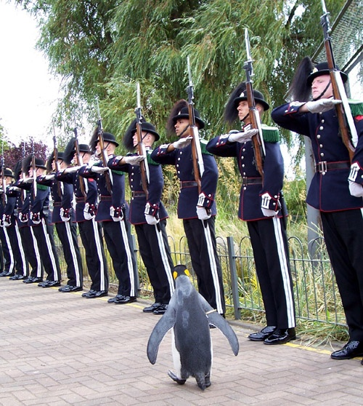
Atent Hut

Slide 34

Over and Out

